Slide 1



AI BASED GAIT RECOGNITION TO IDENTIFY INTRUDERS IN MILITARY BASE
Presented by
Srinivasan S, Aravinth M, Monish G (PCB Warroirs)
Second Year,
Department of ECE
BIT, Sathyamangalam

Slide 2
AI BASED GAIT RECOGNITION TO IDENTIFY INTRUDERS IN MILITARY BASE
OBJECTIVES:
To identify the illegal intruders in military base by combining image processing and machine learning techniques.
To detect the intruders in military base by extracting the Gait features and comparing the data bases using machine learning techniques.

Slide 3
LITERATURE SURVEY
Author Name | Title | Methodology
Jeff P. Fosterin | Automatic gait recognition using area-based metrics. | Five linked biped human locomotion. More vital information is obtained in the set of sequential silhouette images.
Xi Chen | Adaptive silhouette extraction and human tracking in complex and dynamic environments | Fuzzy logic inference system. Disturbance of moving object while extracting human silhouette is avoided.
Ali et al | Gait recognition using radon transform with principal component analysis (PCA) | Principal Component Analysis(PCA) with and without Radon transform. Used to reduce dimension of images without loss of actual information in less duration of time.
Liang Wang et al | Silhouette analysis-based gait recognition for human identification. IEEE transactions on pattern analysis and machine intelligence | Automatic gait recognition method by spatiotemporal silhouette analysis while walking.

Slide 4




PROPOSED METHODOLOGY (DETECTION)
Input image
CCTV image is taken as input image
The image is then converted into silhouette image
Gait features using silhouette images are acquired and compared using KNN algorithm with gait features of military people in the base which is stored as data base.
If the Gait feature is same it repeats the algorithm
If it is not same then it results as intruders
Silhouette image
Gait feature extraction
If matched
Acquired Data Base
Data base of military people
Comparison using KNN algorithm
If not matched
Alerts the camp

Slide 5
PROPOSED METHODOLOGY (PREDICTION)
Input image
CCTV image is taken as input image.
The image is then converted into silhouette image.
The gait features are extracted and data base of military men are stored.
A database with both military men and random intruder is taken and tested using neural network technology.
The samples are trained validated and tested.
Silhouette image
Gait feature extraction
Acquired Data Base
Training and testing using neural network

Slide 6


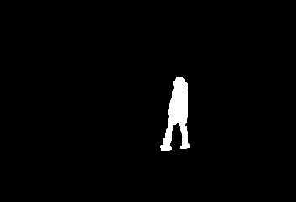
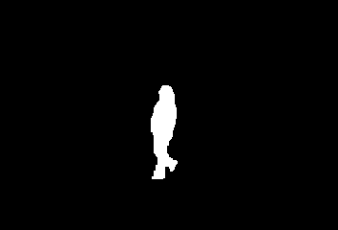
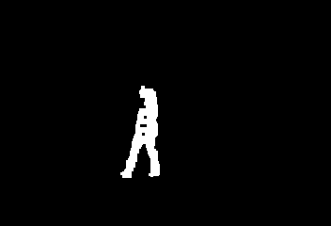




RESULTS AND DISCUSSION
Extracted silhouette images
Gait Feature Extracted
Features | Sample 1 | Sample 2 | Sample 3 | Sample 4
Foot length | 39.33 | 40.44 | 38.25 | 37.42
Hand swing | 35.78 | 40.04 | 41.32 | 38.74
Knee distance | 22.75 | 23.22 | 21.15 | 20.55
Stance width | 79.8 | 78.19 | 78.13 | 78.3
Gait cycle | 119.72 | 119.07 | 116.24 | 116.31

Slide 7
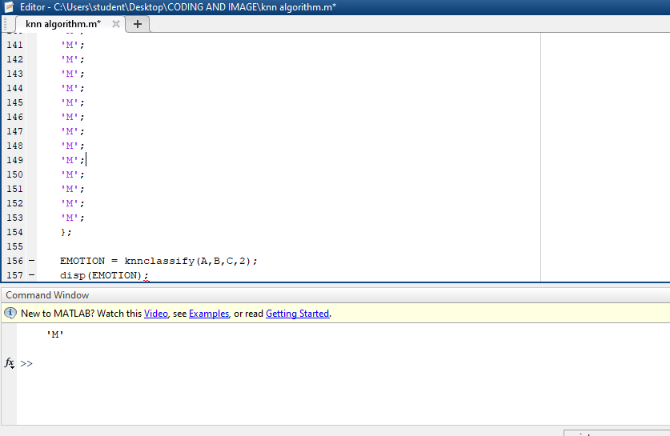
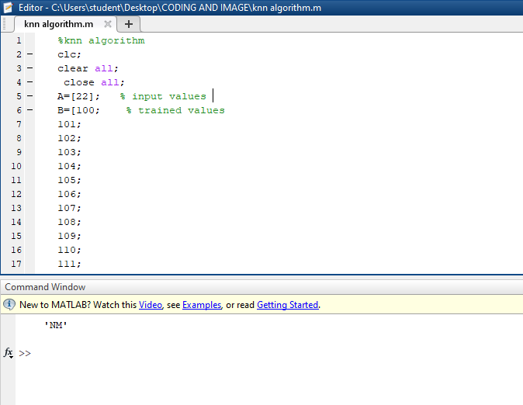
CONT…(PREDICTION BY KNN)
The features are extracted for both military people and intruders
The classification of military and intruders are done by KNN algorithm
The value of K is 2 which represent military and intruders

Slide 8
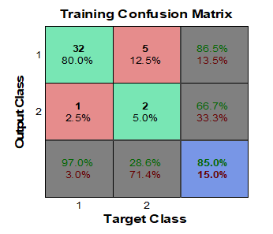
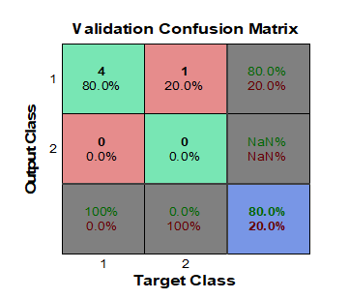
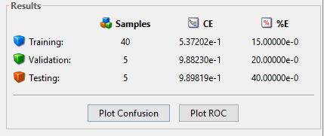
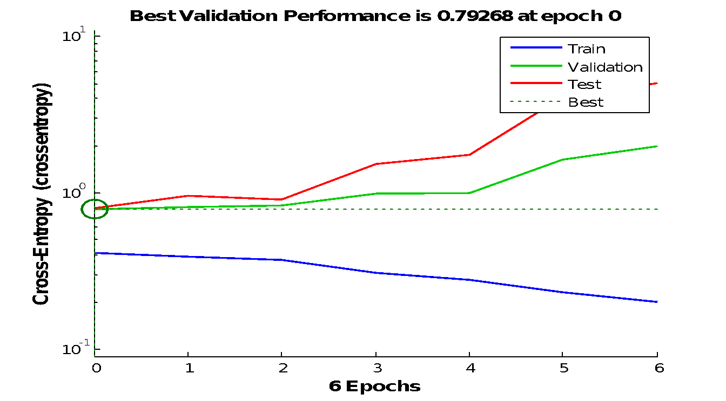
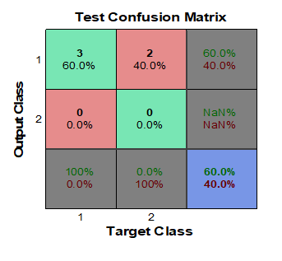
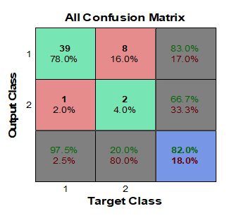
CONT…(PREDICTION BY NN)
TRAINING VALIDATION AND TESTING

Slide 9
CONT…(PREDICTION BY NN)
TRAINING AND CONFUSION MATRIX:
Classification Parameter | Test Images
TP | 39
FP | 8
TN | 2
FN | 1
SENSITIVITY | 97
ACCURACY | 82
PRECISION | 83

Slide 10
CONCLUSION
The gait recognition is to identify intruders in military base is done by comparing the database.
NN predicts the training and testing of the database. The overall training accuracy is found to be 82%
The future scope is to increase the prediction by implementing different machine learning algorithms.

Slide 11

Notes:
Thank You for Watching

